Slide 1

Architectural Home Plan Design Supporting System with Knowledge Base Inspection
Interim Progress I
R.P.M.C.Rajapaksha
ICT/08/09/018
2298

Slide 2
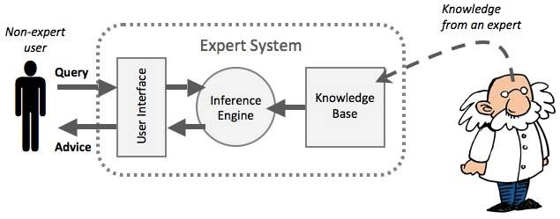
Knowledge base paradigm

Slide 3
Knowledge Base Implementation Categories
Geometrical Rules
Architectural Rules
Legal Rules

Slide 4
Knowledge Base Implementation First Phase
Geometrical Rules
Most difficult implementation
Foundation of generating a design
It is necessary to define the basic shape of a house

Slide 5
Outline of Geometrical Rule Knowledge Base Implementation
Define a Line
Define a Polygon
Find adjacency of two polygons
Find intersection of two polygons
Find overlapping of two polygons
Goal
Issues
Solutions

Slide 6
1. Define A Line
Issue
Generation of coordinates ends up in an infinite loop.
Solution
x1,y1
x2,y2

Slide 7
2. Define A Polygon
Basic Requirements
1. Should have more than three lines.
2. First coordinates of a line should be the last coordinates of the previous line.
3. First coordinates of the first line should be equal to last coordinates of the last line.

Slide 8
2. Define a Polygon
x2,y2
Line 1
Line 2
x1,y1
x3,y3
Line 5
Line 3
x5,y5
Line 4
x4,y4

Slide 9
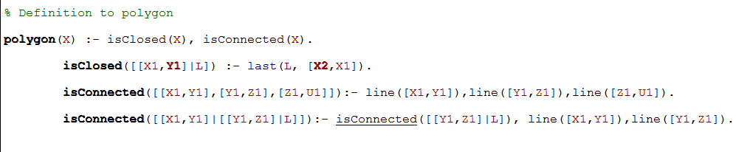
2. Define A Polygon
Prolog Code

Slide 10
Just a set of polygon does not represent a house
They should be interconnected

Slide 11
Just a set of polygon does not represent a house
They should not overlap on each other

Slide 12
3. Find adjacency of two polygons
Find a line common to two polygons
Find the slope of line1 in polygon1-> m1
Find the slope of
line2 In polygon2 -> m2
3. Validate m1 = m2

Slide 13
3. Find adjacency of two polygons
Find a line common to two polygons
Method
Find the slope of lines
Issues
Finding slope needs mathematical calculations like division, square root
Prolog does not support reverse calculations for division
Prolog Code
adjacentLine([[X1,Y1],[X2,Y2]],[[X3,Y3],[X4,Y4]], T1, T2) :- T1 is (Y2-Y1)/(X2-X1), T2 is (Y4-Y3)/(X4-X3), T1 is T2, (Y1-Y3)/(X1-X3) = T1, Sqrt(2,(((X1-X2)*(X1-X2))+((Y1-Y2)*(Y1-Y2)))) = (Sqrt(2, (((X1-X3)*(X1-X3))+((Y1-Y3)*(Y1-Y3)))) + Sqrt(2, (((X3-X2)*(X3-X2) + ((Y3-Y2)*(Y3-Y2)))))).

Slide 14
3. Find adjacency of two polygons
Solution
A
B
Polygon 1 [(A,B),(B,C),(C,D),(D,A)]
Polygon 1
Polygon 2 [(E,F),(F,G),(G,H),(H,E)]
D
C
E
F
Polygon 2
Polygon 1 [(A,B),(B,C),(C,F),(F,E),(E,D),(D,A)]
H
G
Polygon 2 [(E,F),(F,G),(G,H),(H,E)]

Slide 15
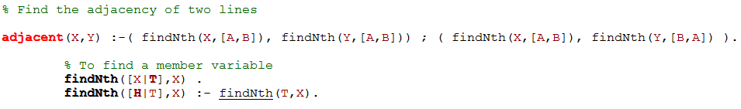
3. Find adjacency of two polygons
Prolog Code
Solution
Break a polygon line to several lines at the common region of a line

Slide 16
4. Find intersection of two polygons
Find a common point shared by two polygons
Method
Find intersection of two lines

Slide 17
4. Find intersection of two polygons Solution 1
y
l2y2
l1y2
l2y2-l1y3
l2y3-l1y2
l2y3
l1y3
l1y1
l2y2
l2x1
x
l1x1
l1x2
l2x2
Common X region

Slide 18
4. Find intersection of two polygons Solution 1(cont)
Equation
(l2y1-l1y2)(l1x2-l1x1) + (l1y2-l1y1)(l1x2-l2x1) *
(l1x2-l1x1)
(l2y1-l1y2)(l1x2-l1x1) - (l2y1-l2y2)(l1x2-l2x1) > 0
(l2x2-l2x1)
(l2y2-l1y3) *
(l2y3-l1y2) > 0
+
+
+
+
+
+
+
+
+
+

Slide 19
4. Find intersection of two polygons Solution 1(cont)
y
l1y2
l1y4
l2y2
l2y2-l1y3
l2y2-l1y4
l1y3
l1y1
l2y2
l2x1
x
l1x1
l2x2
l1x2
Common X region

Slide 20
4. Find intersection of two polygons Solution 1(cont)
Equation
(l2y1-l1y2)(l1x2-l1x1) - (l1y2-l1y1)(l1x2-l2x1) *
(l1x2-l1x1)
(l2y1-l1y2)(l1x2-l1x1) - (l2y1-l2y2)(l1x2-l2x1) > 0
(l2x2-l2x1)
(l2y2-l1y3) *
(l2y3-l1y2) > 0
+
+
+
+
+
-
+
+
+
+

Slide 21
4. Find intersection of two polygons Solution 1(cont)
Prolog Code
lineNotIntersect([[L1X1,L1Y1],[L1X2,L1Y2]],[[L2X1,L2Y1],[L2X2,L2Y2]]) :- L1X1<L1X2, L2X1<L2X2, (L1X1<L2X1 ; L1X1 is L2X1), (L1X2<L2X2 ; L1X2 is L2X2), (((L2Y1-L1Y2)*(L1X2-L1X1)) - ((L2Y1-L2Y2)*(L1X2-L2X1))) > 0.
lineNotIntersect([[L1X1,L1Y1],[L1X2,L1Y2]],[[L2X1,L2Y1],[L2X2,L2Y2]]) :- L1X1<L1X2, L2X1<L2X2, L1X1<L2X1, L1X2>L2X2, (((L2Y2-L1Y1)*(L1X2-L1X1)) - ((L1Y1-L1Y1)*(L2X2-L1X1))) > 0.
checkPolygonInterSection(X,Y) :- append(X,Y,R),checkIntersection(R).
checkIntersection([H,T]) :- lineNotIntersect(H,T).
checkIntersection([H|[H1|T]]) :- lineNotIntersect(H,H1), checkIntersection([H|T]), checkIntersection([H1|T]).

Slide 22
4. Find intersection of two polygons Solution 1(cont)
Method
Get the common X regions of two lines and get the difference of Y coordinates of two lines at the common X points and the difference should be greater than zero if lines are not intersecting.
Issues
When prolog generates the coordinates of the lines, it generates the coordinates without following a particular order. To apply coordinates to above function coordinates should be in a particular order. Sorting the coordinates of a line in prolog is really hard since a coordinate is coupled with it’s X and Y values.

Slide 23
4. Find intersection of two polygons (cont)
Solution 2
Find the common point of two lines using Bresenham’s line drawing algorithm.
Get rid of divisions and square root calculations
Issues
If the common point lies in a fraction value it will not be identified by the Bresenham’s algorithm.
If a line contains millions of pixel points to calculate all the pixel points using this algorithm takes much time and increases the complexity.

Slide 24
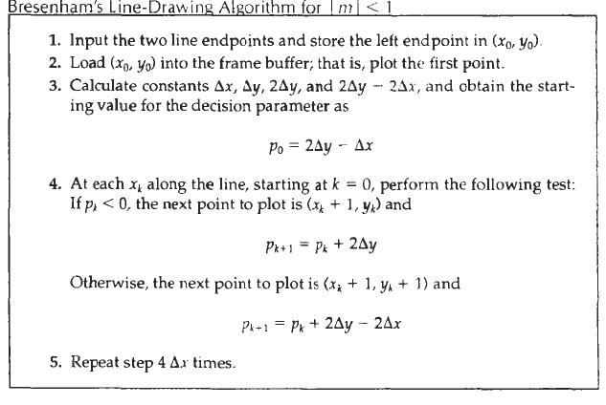
4. Find intersection of two polygons Solution 2(cont)

Slide 25
4. Find intersection of two polygons Solution 2(cont)
Prolog Code
addToList(H,[H|T],T).
addToList(X,[H|T],[H|R]) :- addToList(X,T,R).
checkIntersection([P1,P2], [P3,P4]) :- lineDraw([P1,P2], L1), lineDraw([P3,P4], L2), findNth(L1,X), findNth(L2,X).
lineDraw([[X1,Y1],[X2,Y2]],R) :- X1<X2, getPo([[X1,Y1],[X2,Y2]], Po), getLine([[X1,Y1],[X2,Y2]],R , Po, DeltaY, DeltaX), DeltaY is Y2-Y1, DeltaX is X2-X1.
getPo([[X1,Y1],[X2,Y2]], Po) :- Po is 2*(Y2-Y1) - (X2-X1).
getLine([[X2,Y2],[X2,Y2]],R, Po, DeltaY, DeltaX).
getLine([[X1,Y1],[X2,Y2]],[H|T], Po, DeltaY, DeltaX) :- ( Po<0, addToList(N,R,[H|T]), N is (X1+1,Y1), Pk1 is Po + (2*DeltaY), getLine(N,[X2,Y2],R ,Pk1 ,DeltaY, DeltaX) ) ; ( Po>0, addToList(N,R,[H|T]), N is (X1+1,Y1+1), Pk1 is Po + (2*DeltaY-2*DeltaX), getLine(N,[X2,Y2],R, Pk1, DeltaY, DeltaX) ).

Slide 26
4. Find intersection of two polygons Solution 3
y
l2y2
l1y2
x0 , y0
l1y1
l2y2
l2x1
x
l1x1
l1x2
l2x2
X region line 1
X region line 2

Slide 27
4. Find intersection of two polygons Solution 3(cont)
Equation
x0 = (x1*x3*y2 - x2*x3*y1 - x1*x4*y2 + x2*x4*y1 - x1*x3*y4 + x1*x4*y3 + x2*x3*y4 - x2*x4*y3)
(x1*y3 - x3*y1 - x1*y4 - x2*y3 + x3*y2 + x4*y1 + x2*y4 - x4*y2)
l1x1 < x0 < l1x2 AND
l2x1 < x0 < l2x2

Slide 28
4. Find intersection of two polygons Solution 3(cont)
Solution
Define the intersection point of two lines using coordinates of the two lines and then the common X point should be in the both X coordinates range of lines.
Challenges
To implement above algorithm in prolog I should have to write specific prolog code for
Addition
Multiplication
Comparison

Slide 29
4. Find intersection of two polygons Solution 3(cont)
Prolog Implementation for Arithmetic Addition
Reason
Add two numbers using “+” operator is not supporting reverse functions like subtraction
Issues Identified in implementation
Implemented prolog code just satisfies adding numbers in same amount of number bits
When going to solve above prolog adds unnecessary zero values in front of the numbers
Depth should be limited since when we call reverse function it ends up in an infinite loop

Slide 30
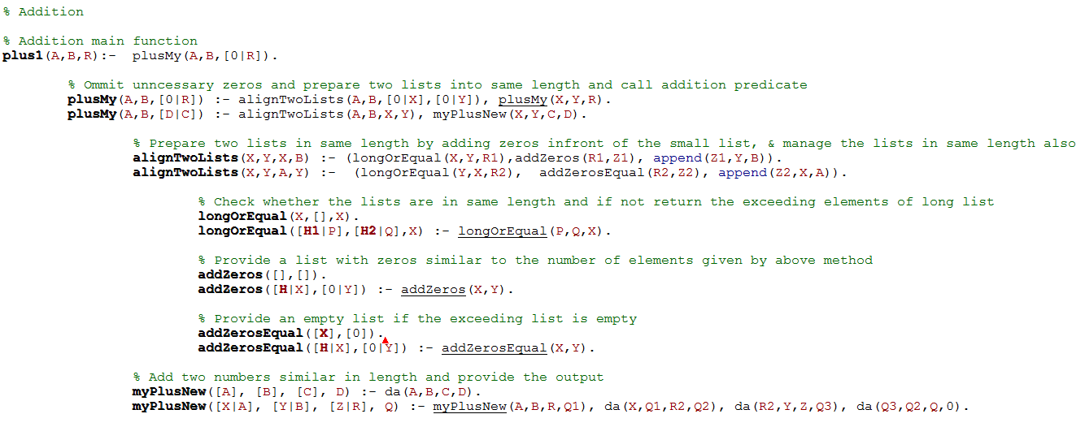
Prolog Implementation for Arithmetic Addition
194
067
261
1
1

Slide 31
4. Find intersection of two polygons Solution 3(cont)
Prolog Implementation for Arithmetic Multiplication
Reason
Multiply two numbers using “*” operator is not supporting reverse functions.
Issues identified in implementation
Adding zero elements to front and end of the number lists.
Solution
Adding zeros to front of the lists has been already solved by prolog addition implementation
Solved adding zeros to end of the result of row multiplication

Slide 32
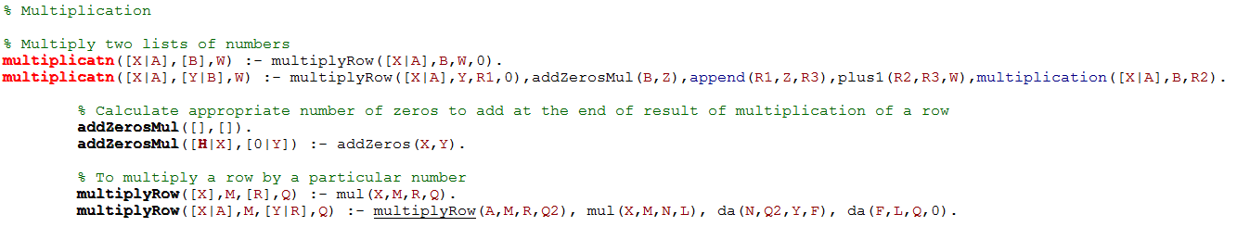
4. Find intersection of two polygons Solution 3(cont)
Prolog Implementation for Arithmetic Multiplication
194
67
01358
11640
12998
2
0

Slide 33
4. Find intersection of two polygons Solution 3(cont)
Prolog Implementation for Arithmetic Comparison
Reason
Comparison of two numbers using “< and >” operators are not supporting reverse functions.
Issues identified in implementation
Adding zero elements to front of the number lists.
Solution
Adding zeros to front of the lists has been already solved by prolog addition implementation

Slide 34
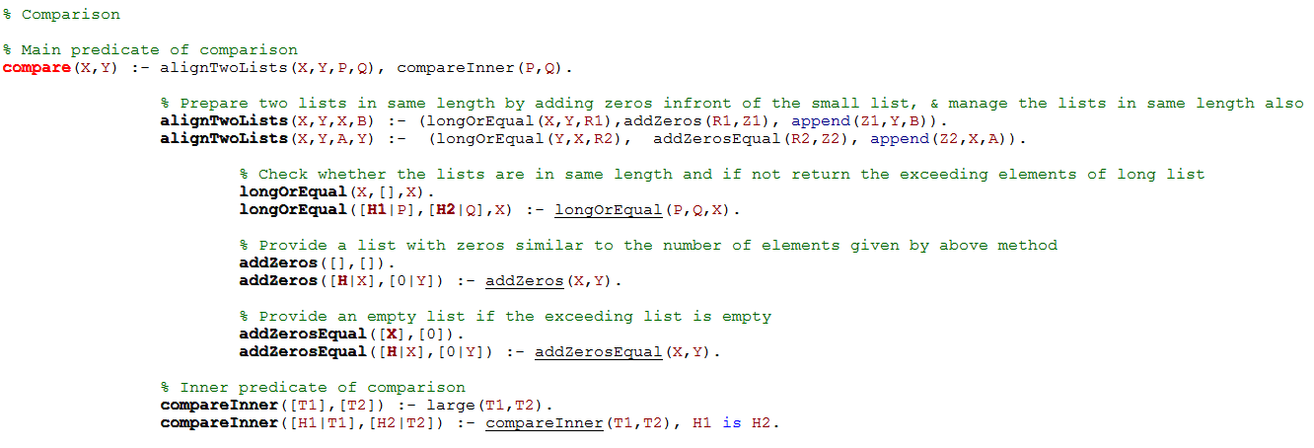
Prolog Implementation for Comparison

Slide 35
Write the output of the predicate to text file
line(A,B), open('out.txt', write, Out), write(Out,N), close(Out).
Graphic design in Visual Studio
Read the text file output in visual studio
Generate a polygon

Slide 36
Knowledge Base Implementation Next Phase
Geometrical Rules
Find the overlapping of two polygons
Architectural Rules
Legal Rules

Slide 37
Thank You

Slide 38
Find overlapping of two polygons
Count intersecting points
Method
Draw a line from the middle point of a line to other polygon and count the points that intersect other polygon.
If count gives an odd value polygons are not intersecting.
If count gives even value polygons are intersecting.

Slide 39
Find intersection of two polygons Solution 3(cont)
Prolog Implementation for Arithmetic Addition
Solution
If two lists are in same length I should have to define a specific method to skip adding zeros to that list.
Depth limit
Visual studio – graphical display
Write to text
Read from text

Slide 40
Find overlapping of two polygons
Count intersecting points

